Slide 1
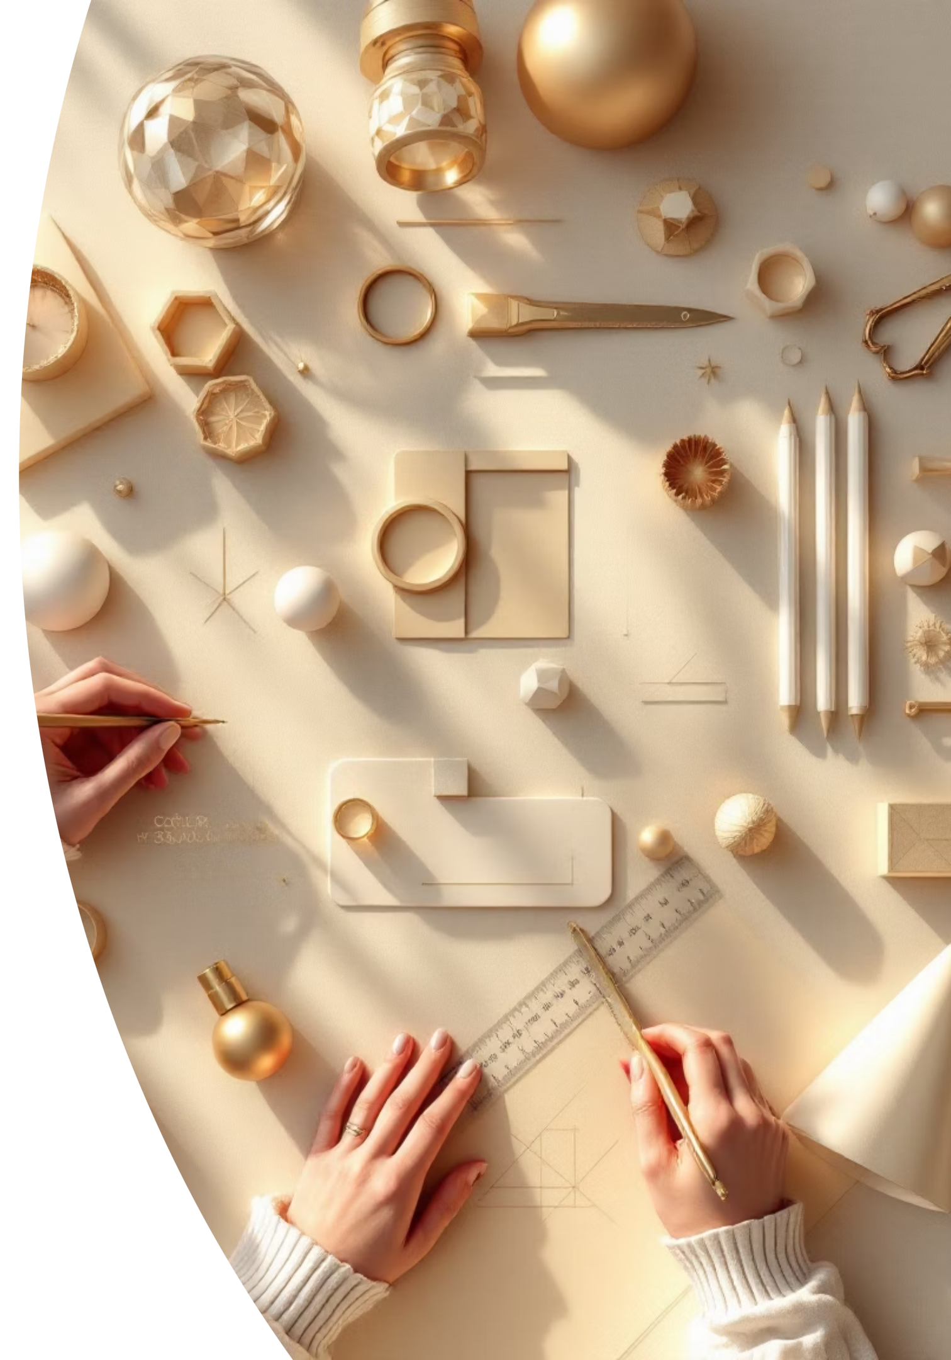
Geometry Reasoning
It is about using shapes, sizes, and positions to solve problems.
We don't just look at shapes; we think and reason about them.

Slide 2
Key Ideas in Geometry Reasoning
Identifying Shapes
2D Shapes (flat)
3D Shapes (solid)
square, rectangle, triangle, circle, etc.
cube, cuboid, cone, cylinder, sphere.
👉 Reasoning example: A ball is round all over → It is a sphere. A box of soap has 6 rectangular faces → It is a cuboid.

Slide 3
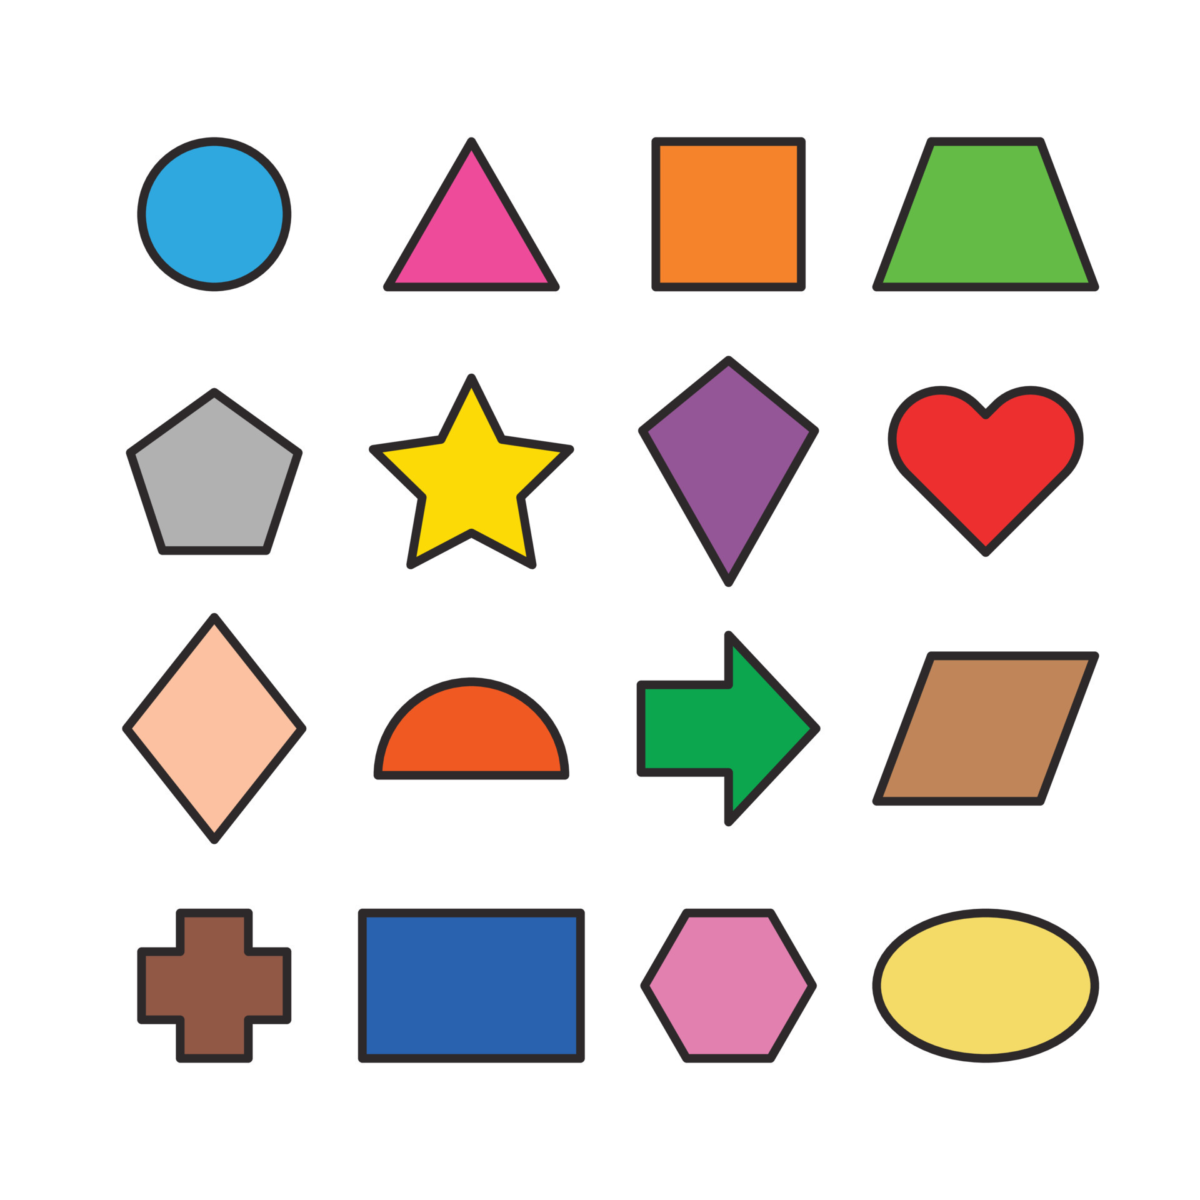

Slide 4
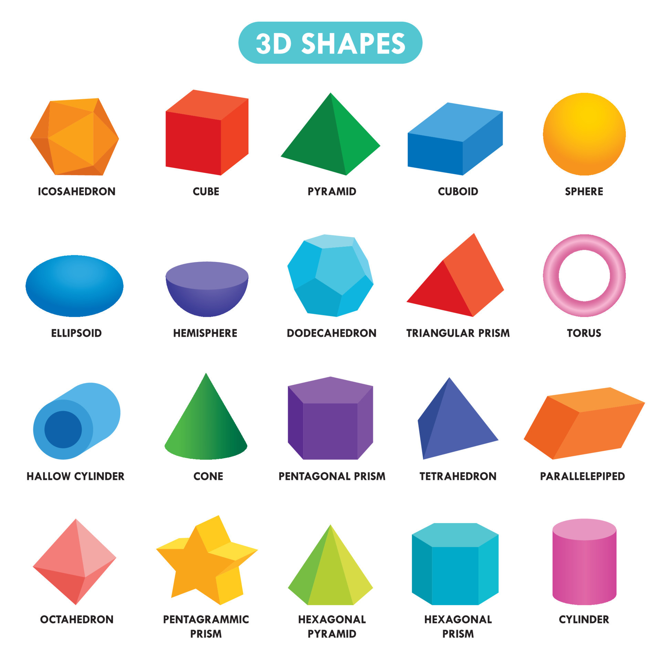

Slide 5
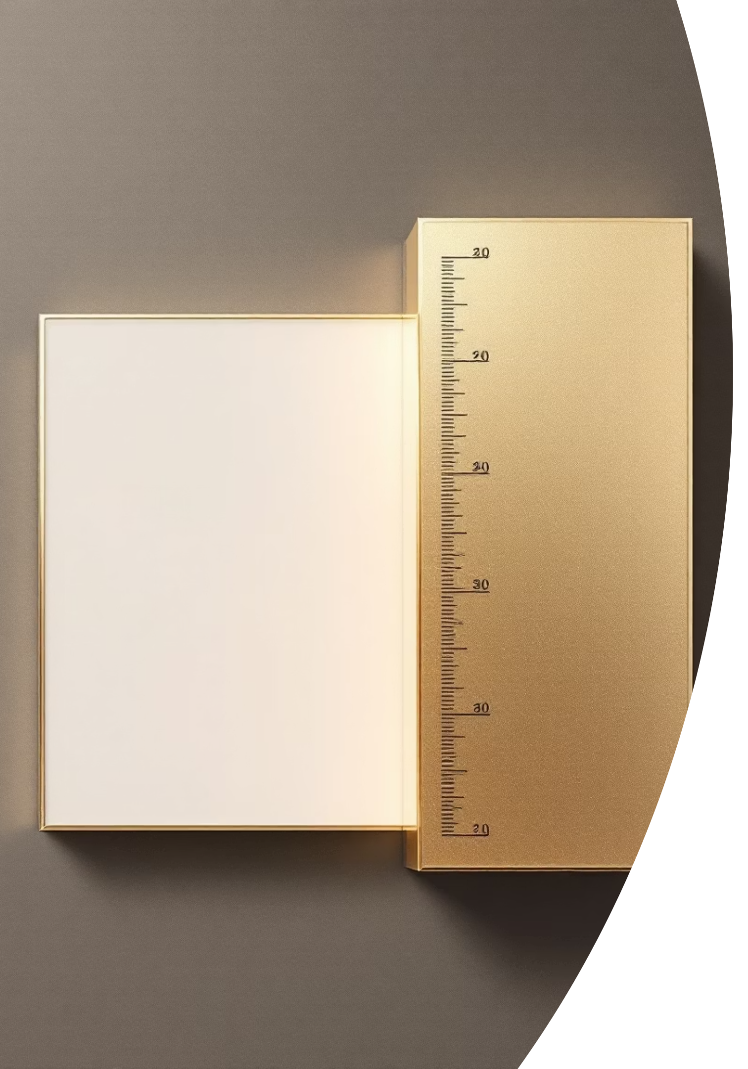
Comparing Shapes
Square vs Rectangle
Triangle vs Quadrilateral
Both have 4 sides, but in a square all sides are equal.
Triangle has 3 sides, quadrilateral has 4.
👉 Reasoning example: If a shape has 4 equal sides and 4 right angles, it is a square.

Slide 6

Symmetry in Geometry
A shape is symmetrical if it can be folded into two equal halves.
1
2
3
Circle
Square
Rectangle
many lines of symmetry.
4 lines of symmetry.
2 lines of symmetry.
👉 Reasoning example: If a shape can be folded into 2 equal parts in more than one way, it has more than one line of symmetry.

Slide 7
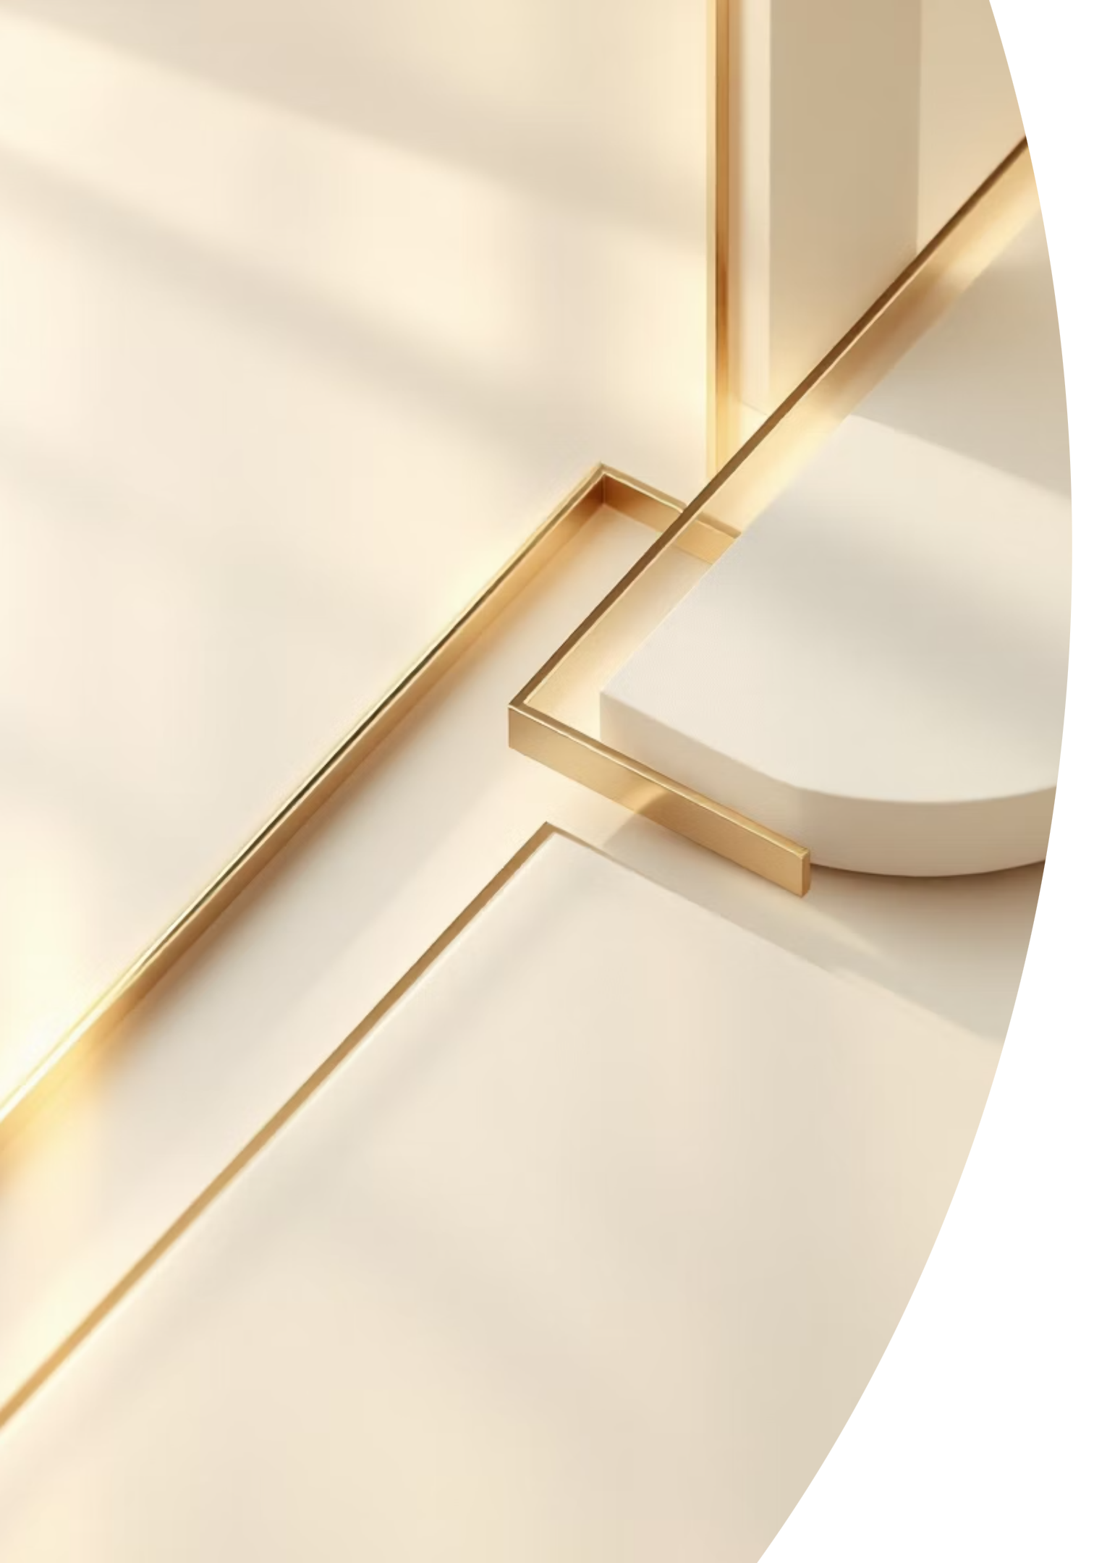
Understanding Angles
Right angle = 90°
Acute angle < 90°
(like the corner of a book)
(smaller than right angle)
Obtuse angle > 90° but < 180°
(bigger than right angle)
👉 Reasoning example: If an angle is bigger than a right angle but smaller than a straight line, it is an obtuse angle.

Slide 8
Examples for Practice
1
Shape Identification
1
Symmetry Analysis
A shape has 3 sides. What is it? → Triangle.
If a shape can be folded into 2 equal parts only one way, how many lines of symmetry does it have? → 1.
2
Property Recognition
A figure has 4 equal sides and 4 right angles. What is it? → Square.
2
Angle Measurement
What angle do the hands of a clock form at 3 o'clock? → Right angle (90°).

Slide 9
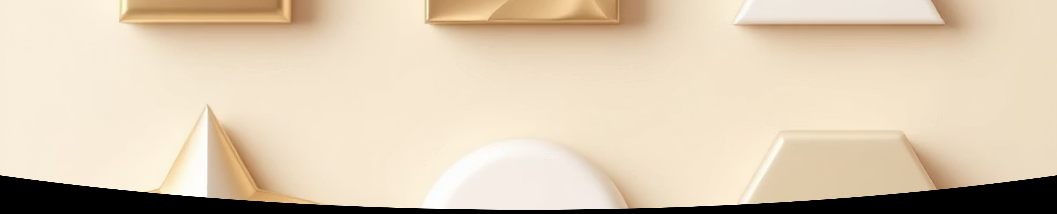




2D Shapes in Detail
2D shapes are flat figures that have only length and width. They are the foundation of geometry reasoning.
Square
Rectangle
4 equal sides, 4 right angles
4 sides, 4 right angles, opposite sides equal
Triangle
Circle
3 sides, 3 angles
Round shape, all points equidistant from center

Slide 10
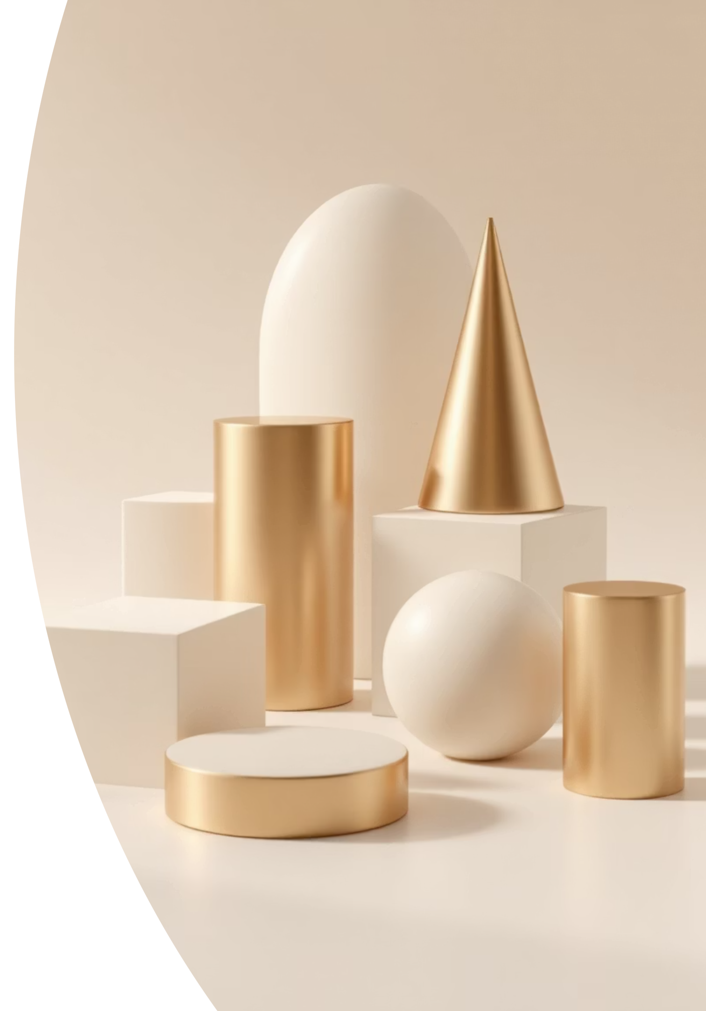
3D Shapes in Detail
3D shapes have length, width, and height. They occupy space and have volume.
Cube
Cuboid
6 square faces, 8 vertices, 12 edges
6 rectangular faces, 8 vertices, 12 edges
👉 Reasoning: A dice is a cube because it has 6 equal square faces.
👉 Reasoning: A box of soap has 6 rectangular faces → It is a cuboid.
Sphere
No faces, edges, or vertices; perfectly round
👉 Reasoning: A ball is round all over → It is a sphere.

Slide 11

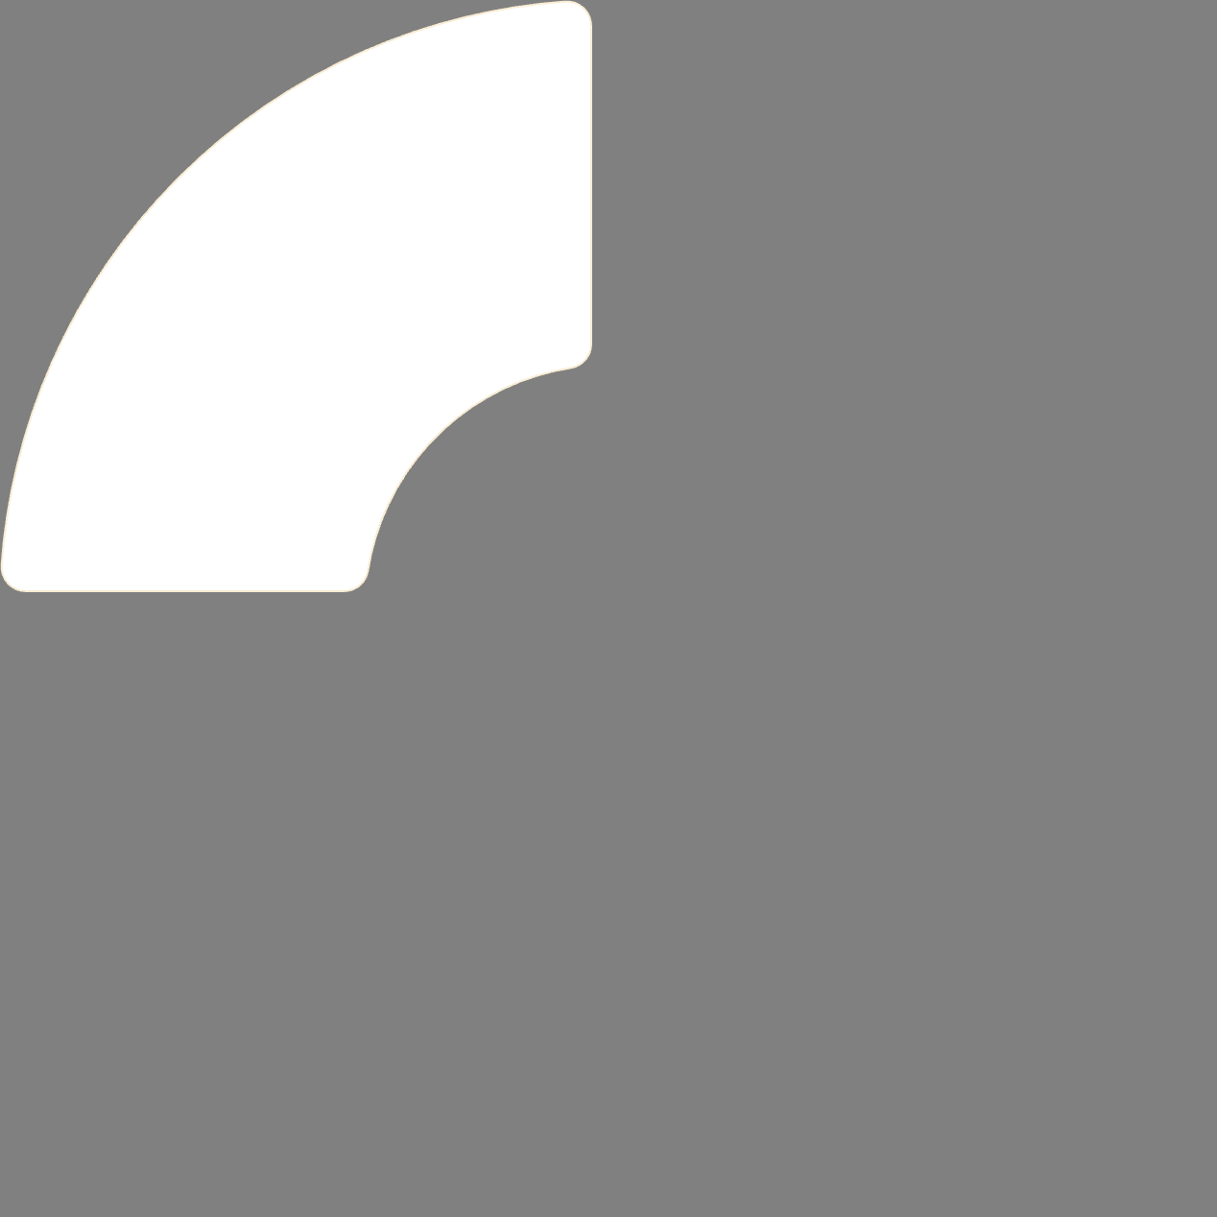
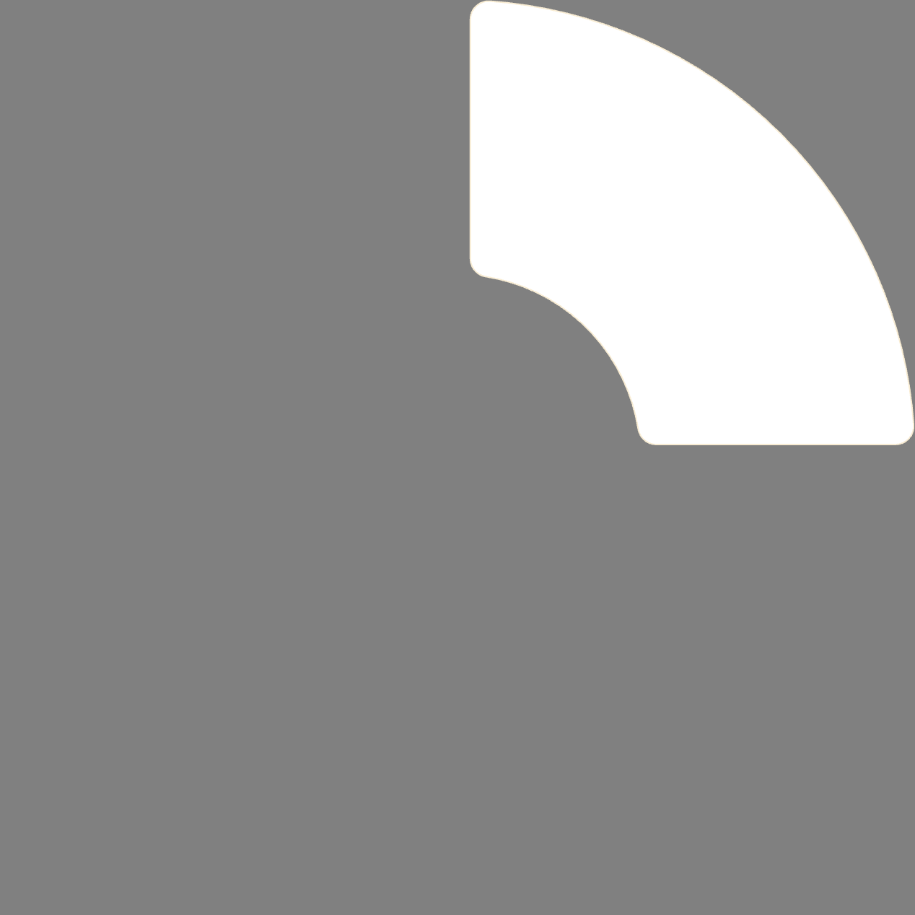

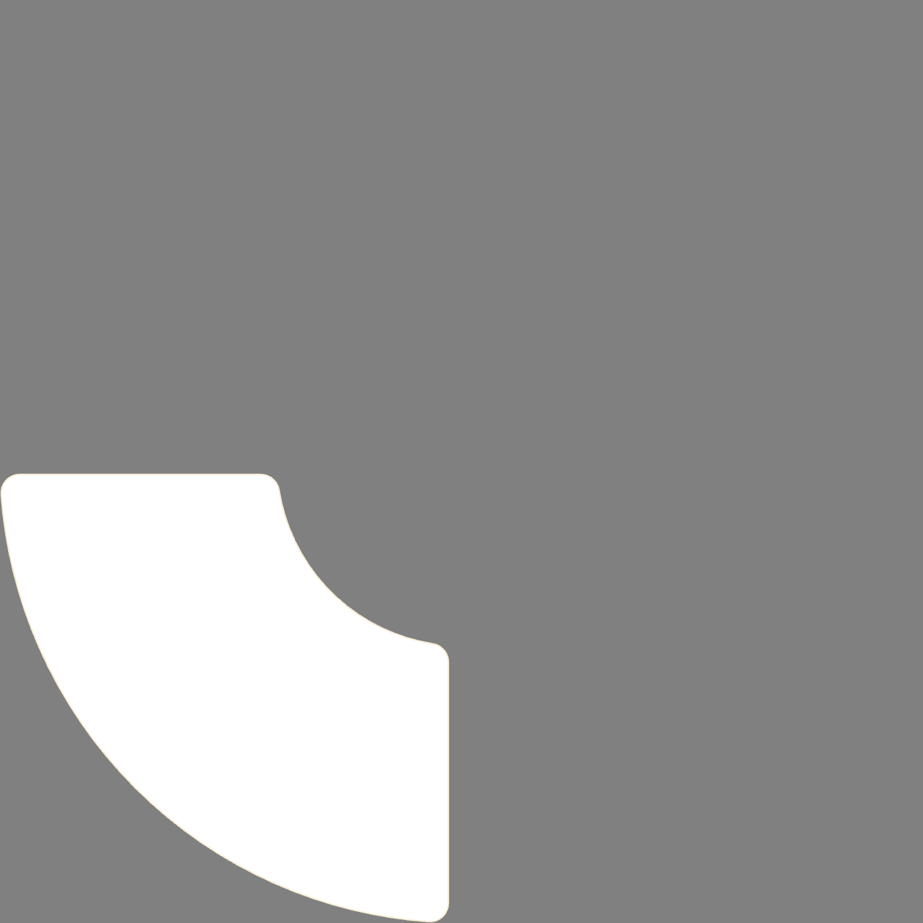

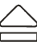

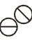
Symmetry Exploration
What is Symmetry?
A shape is symmetrical if it can be folded into two equal halves.
The fold line is called a line of symmetry.
👉 Reasoning example: If a shape can be folded into 2 equal parts in more than one way, it has more than one line of symmetry.
Circle
Square
Infinite lines of symmetry
4 lines of symmetry
Equilateral Triangle
Rectangle
3 lines of symmetry
2 lines of symmetry

Slide 12
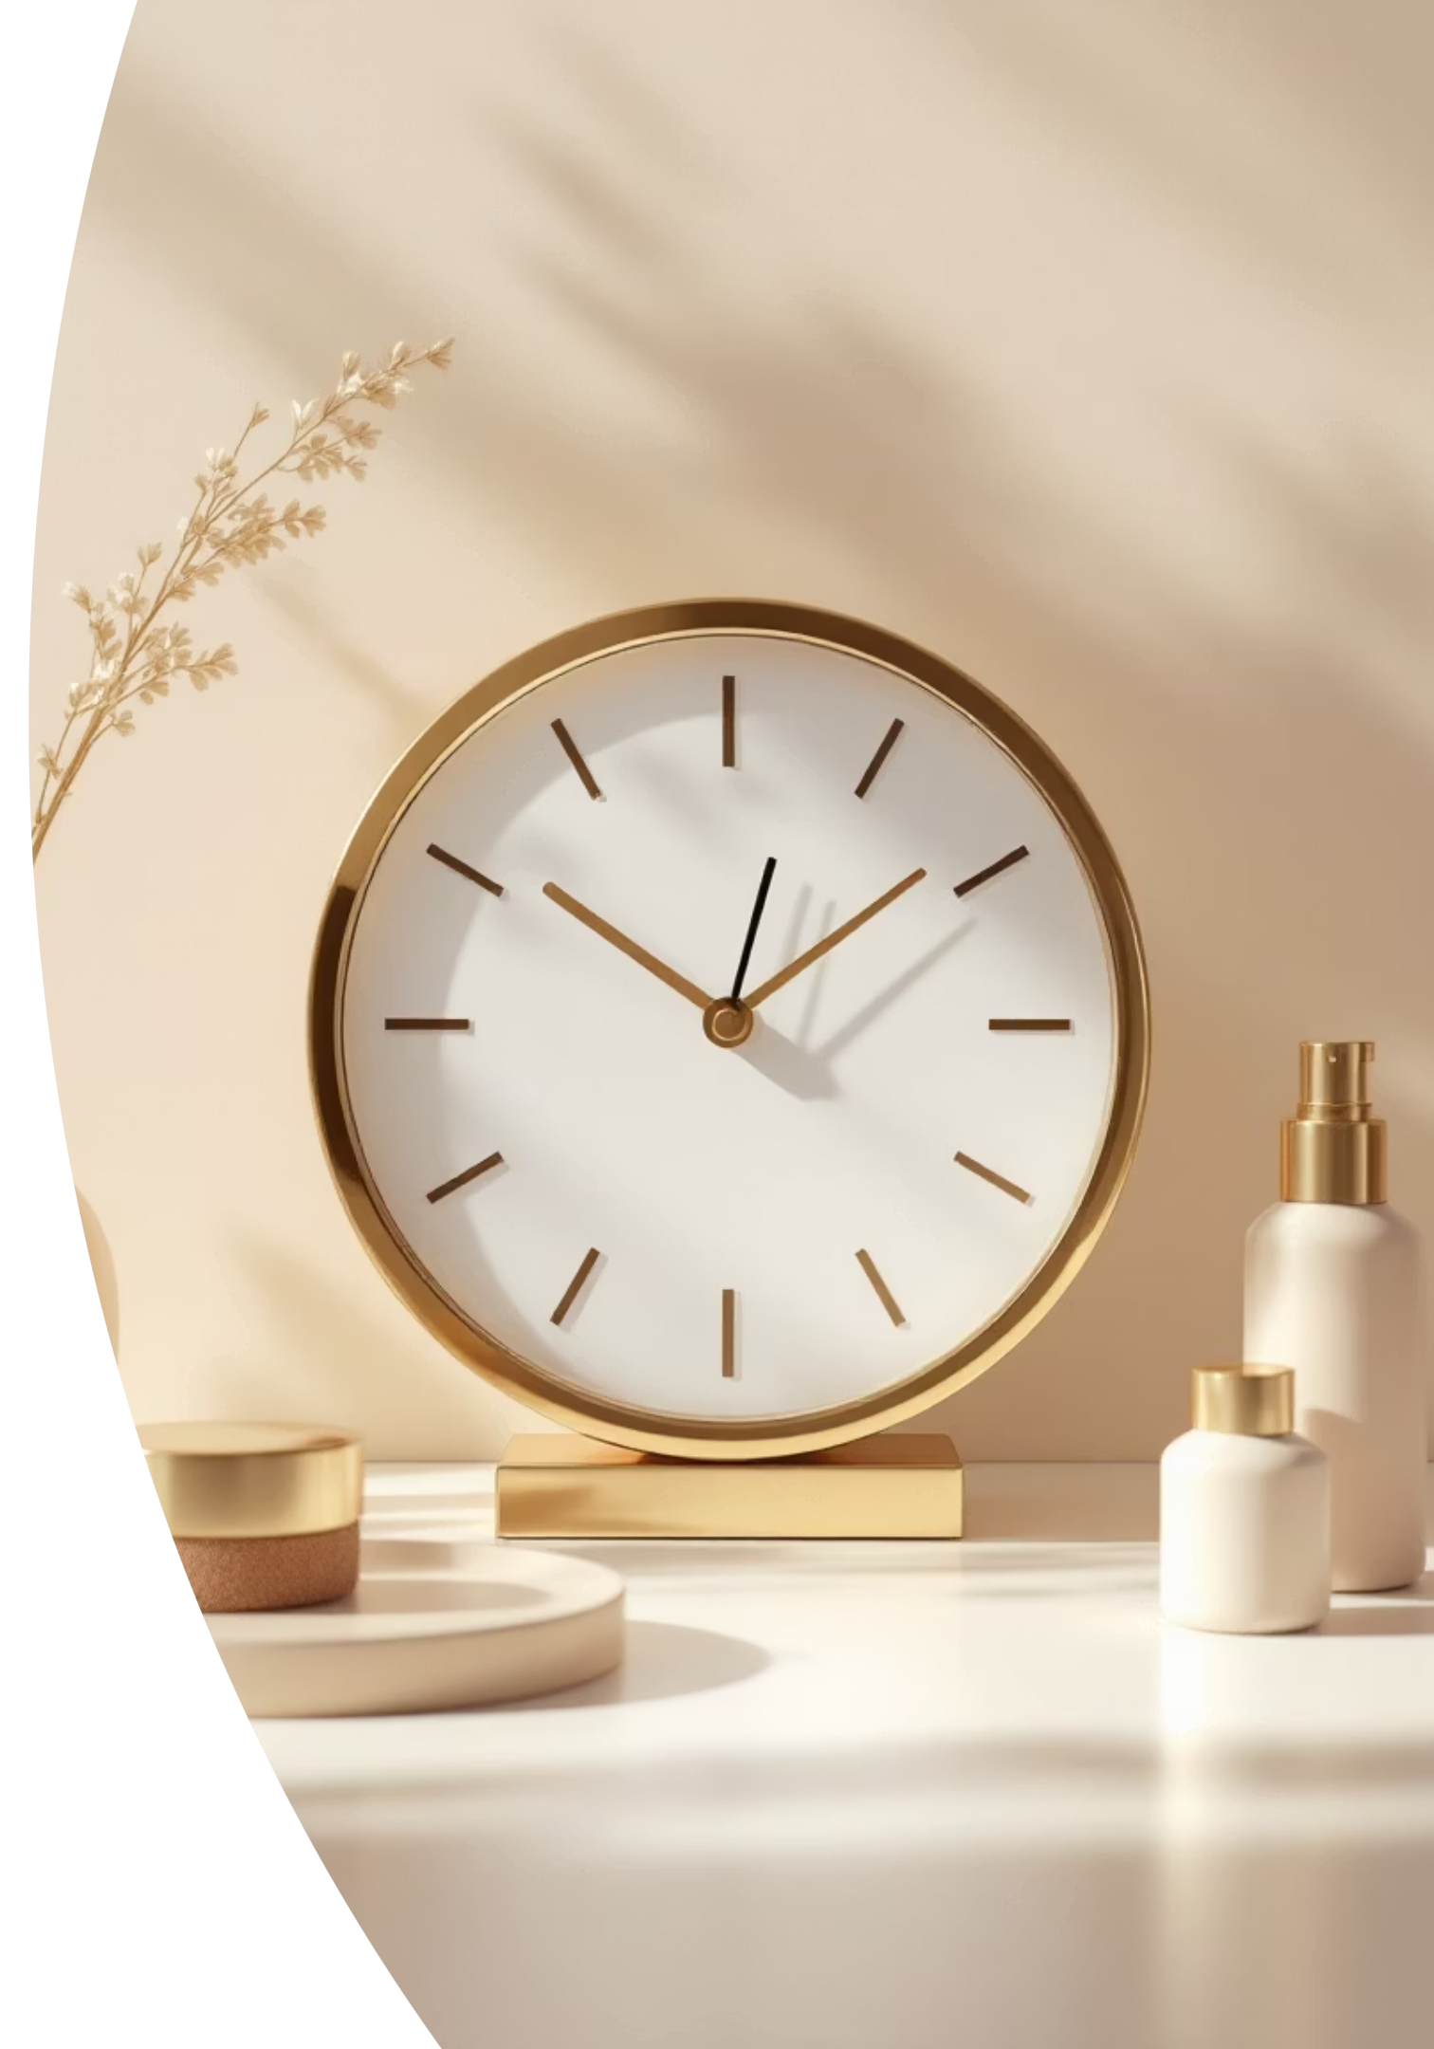
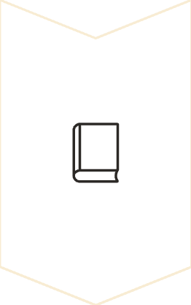
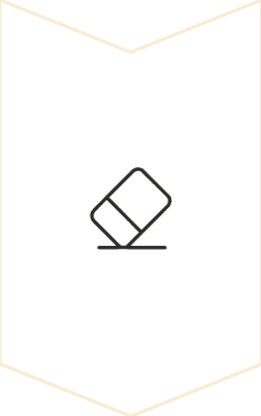
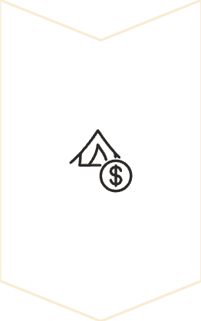
Angles in Real Life
Angles are all around us in everyday objects and situations.
Right Angle (90°)
Like the corner of a book
Example: Clock hands at 3 o'clock form a right angle
Acute Angle (< 90°)
Smaller than a right angle
Example: Clock hands at 2 o'clock form an acute angle
Obtuse Angle (> 90° but < 180°)
Bigger than a right angle
Example: Clock hands at 4 o'clock form an obtuse angle
👉 Reasoning example: What angle do the hands of a clock form at 3 o'clock? → Right angle (90°).

